Slide 1

Graduate Admission Analysis
Presented by: Yassir Benabdallah

Slide 2
Agenda
Introduction
Methodology and Dataset Description
Statistical Tests
Conclusion and Discussion

Slide 3

Introduction
Nowadays, academic performances of students have been one of the hot debated issue to be discuss today.
Graduate admission to a particular university can also be one of the most important aspect to be focused on in one’s life.
It is important to determine if the academic performance affects the chances of students getting admission by a university of the student’s choice
Notes:
nowadays, academic performances of students have been one of the hot debated issue to be discuss today. As time goes by, many people has put more attention in having a good academic performance as they believed that the most crucial aspect to focus on to achieve success is by having a good grades in any subject or getting a high marks for any examination. Not only that, graduate admission to a particular university can also be one of the most important aspect to be focused on in one’s life as it can determine someone’s future. It is convenient for students if there exist a system or research that can help them in shortlisting the universities of their choices based on their profiles. Hence, the purpose of this case study is to determine if the academic performance affects the chances of students getting admission by a university of their choice. The data set is analyzed through several statistic test such as hypothesis testing 1-sample, hypothesis testing 2-sample, correlation, regression, goodness-of-fit test and also chi-square test of independence to yield an accurate result. R-studio software has been used to carry out the statistical analysis on the chosen variables in the data set.

Slide 4

Methodology & Dataset Description
The data set is analyzed through several statistic test:
Hypothesis testing 1
Hypothesis testing 2
Correlation
Regression
The dataset is composed of:
500 examples
9 features
Notes:
Goodness of fit: a statistical hypothesis test used to see how closely observed data mirrors expected data
Chi-Square: A chi-square (χ²) statistic is a test that measures how a model compares to actual observed data.

Slide 5

Statistical Tests

Slide 6
Hypothesis Testing 1-Sample
We use GRE Score for this analysis.
We use Z-Test because the variance is unknown.
Let us determine if the mean of GRE Score is different from 310 given that the significance level is 0.05.
Hypothesis Statement:
H0: μ = 310 ( Population mean of GRE.Score is equal to 310 )
H1: μ ≠ 310 ( Population mean of GRE.Score is different from 310 )

Slide 7
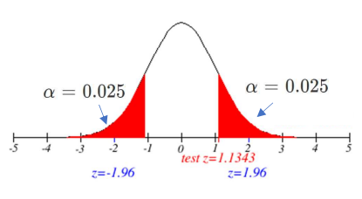
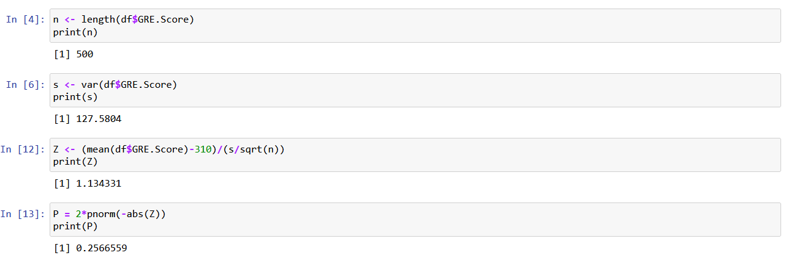
Hypothesis Testing 1-Sample (Contd.)
z-test = 1.1343 is less than z0.025 = 1.96 and greater than -z0.025 = -1.96
Hypothesis is failed to be rejected
Notes:
Since test statistic, z-test = 1.1343 is less than z0.025 = 1.96 and greater than -z0.025 = -1.96, thus, null hypothesis is failed to be rejected. To conclude, there is not strong evidence to conclude that the mean GRE Score of a student is differs from 310 at significance level of 0.05.

Slide 8
Hypothesis Testing 2-Sample
Students with research experience VS. Students with no research experience
0.05 Significance level.
The variances of both groups are assumed not equal.
Hypothesis Statement:
H0: μ1 = μ2 (sample mean of chance of admission of students with research experience equal with sample mean of chance of admission of students without research experience)
H1: μ1 ≠ μ2 (sample mean of chance of admission of students with research experience differs with sample mean of chance of admission of students without research experience)
Notes:
As there are several academic performance measurements that can be considered, I wish to determine whether there is any difference between the mean of chance of admission of students with research experience with the mean of chance of admission of students without research experience under the t-test of 5% significance level. The dataset is then split into 2 groups based on the value of the Research column which is students with research experience and students without research experience. The variances of both groups are assumed not equal since I cannot reasonably predict that both of groups of data are having the same variances.

Slide 9
Variables
μ1 = sample mean of chance of admission of students with research experience
μ2 = sample mean of chance of admission of students without research experience
n1 = sample size of chance of admission of students with research experience
n2 = sample size of chance of admission of students without research experience
variance1 = sample variance of chance of admission of students with research experience
variance2 = sample variance of chance of admission of students without research experience
t0 = test statistic
v = degrees of freedom

Slide 10
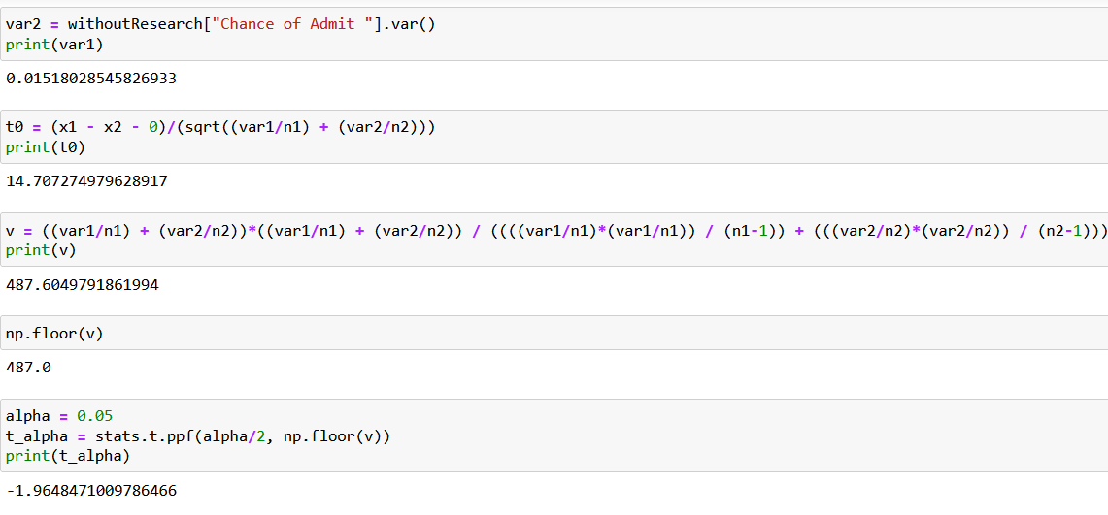
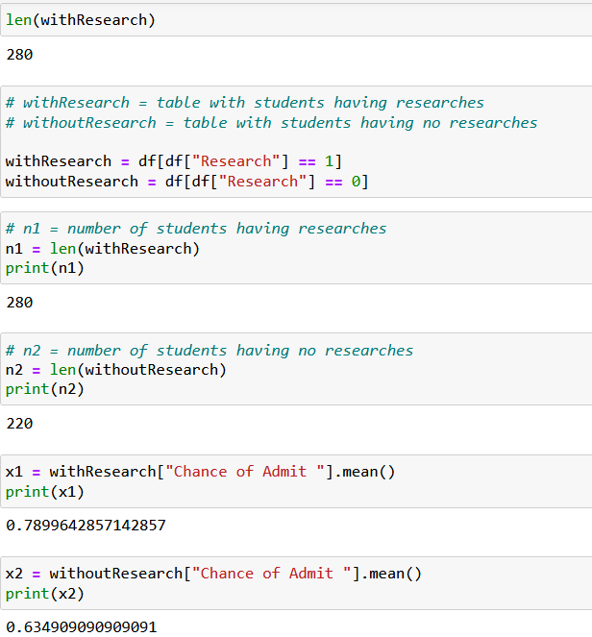
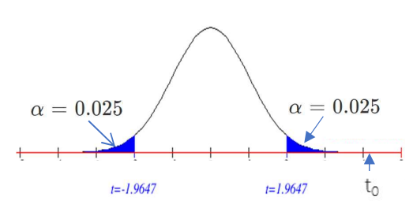
Hypothesis Testing 2-Sample (Contd.)
t0 = 14.707 > t0.025, 487.6 = 1.965
Null hypothesis is rejected.
Notes:
Based on the figure above,
Test statistic, t0 = 14.707
Significance level, α = 0.05 5
Degree of freedom, d.f = 487.6 = 487
H0 will be rejected if t0< -t0.025, 487.6 = -1.965 or if t0*> t0.025, 487.6 = 1.965.
Since t0 = 14.707 > t0.025, 487.6 = 1.965, null hypothesis is rejected.

Slide 11
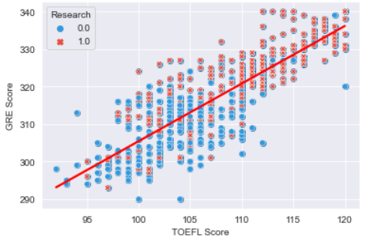
Correlation
We use TOEFL Score and GRE Score
Sample correlation coefficient, r = 0.8272
Notes:
Few variables are selected in conducting this correlation analysis in order to determine the strength of association (linear relationship) between two variables. Hence, more than one correlation analysis has been done by using different variables.
it can be seen that TOEFL.Score increases as the GRE.Score increases. Since r = 0.8272, it shows a strong positive linear relationship. A scatter plot and correlation analysis of the data indicates that there is relatively strong positive linear association between x, TOEFL.Score and y, GRE.Score.

Slide 12
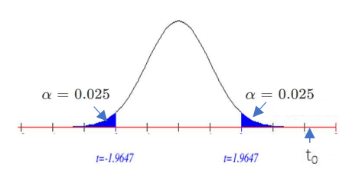
Significance Test for Correlation
Significance level is 0.05
Hypothesis Statement:
H0: ρ = 0 (There is no linear correlation between TOEFL Score and GRE Score)
H1: ρ ≠ 0 (There exists linear correlation between TOEFLScore and GRE Score)
Test statistic, t0 = 32.852
P-value = 2.2x10-16
Critical value: -t_{0.025, 487.6} = -1.9647
and t_{0.025, 487.6} = 1.9647
Notes:
To provide more evidence in supporting the fact that there is a linear relationship between TOEFL.Score and GRE.Score, a significance test is conducted at significance level of 0.05.
GRAPH: the p-value of the correlation analysis is 2.2x10-16. Hence, since the p-value is less than significance level of 0.05, the null hypothesis is rejected. Therefore, there is sufficient evidence of linear relationship between TOEFL Score and GRE Score of students at the 5% level of significance.

Slide 13
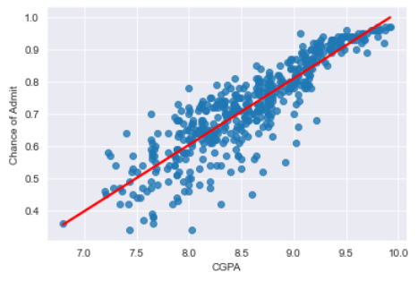
Regression
Dependent variable (y) and independent variable (x)
Y = Chance of Admit
X = CGPA
Notes:
Next, as it is important to describe the impact of one variable that is independent on other variable that is dependent, regression analysis has also been conducted in this case study. Let the dependent variable (y) in this case is the collected variable Chance.of.Admit whereas the independent variable (x) is the variable CGPA. This analysis aims to test the existence of a linear relationship between the variable x and y.

Slide 14
Regression: Interpretation
y = -1.0443 + 0.2059x
Coeffiencient: b₀ = -1.0443
Slope: b₁ = 0.2059
R² = 0.778625
Notes:
Based on the graph generated in Figure 7, the regression model involves a single independent variable and it is called simple regression. The regression model is a positive linear relationship with an equation of (equation)
The value of intersection coefficient, b0 of -1.0443 indicates the estimated average value of Chance.of.Admit (y) when the value of CGPA (x) is 0. Here, as no students would get 0 for CGPA unless they did not participate in any compulsory academic activities, it is safe to say that β0 is just a value of the chance of admit that is not explained by CGPA.
Meanwhile, the value of slope coefficient, b1 of +0.2059 indicates the average value of Chance.of.Admit as a result of a one-unit change in CGPA. In this case, Chance.of.Admit will increase by 0.2059, on average, for each additional one-unit change of CGPA.
Since the R2 = 0.7787 which is between 0 and 1, it can be concluded that there exists a weaker linear relationship between CGPA (x) and Chance.of.Admit (y). Some but not all of the variation in Chance.of.Admit is explained by variation in CGPA. In this case, around 78% of the variation in Chance.of.Admit is explained by variation in CGPA.

Slide 15
Inference about the Slope
Hypothesis Statement:
H0 : β1 = 0 (There no linear relationship between CGPA and Chance of Admit)
H1 : β1 ≠ 0 (There exists linear relationship between CGPA and Chance of Admit)
Notes:
Regression analysis has also been conducted to provide more evidence in testing the existence of a linear relationship between variable x and y.

Slide 16
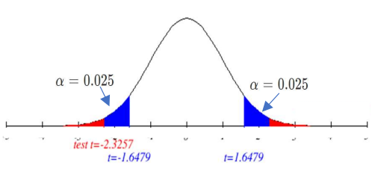
Inference about the Slope (Contd.)
Degree of freedom, d.f = 498
Critical value: -t0.025, 487.6 = -1.6479 and t0.025, 487.6 = 1.6479
Test statistic, t0 = -2.325725
p_value = 2.2x10-16
Notes:
the p-value of the data is 2.2x10-16. Hence, since the value of pvalue is less than the value of 0.05 significance level, null hypothesis is rejected. From the statistical test above, there is convincing evidence to conclude that CGPA does affects the chance of admit of a student.

Slide 17

Conclusion

Slide 18

Thank you!

